Slide 1




Data Analysis Summary
2023
2024
MHS stakeholders were more eager to collaborate with CEPO to deliver accredited continuing education activities
103
Applications Submitted
141
Applications Submitted
CEPO added over 100 more accredited activities to the CEPO website in 2024 compared to 2023
409
Activities Accredited
540
Activities Accredited
CEPO awarded over 60,000 more CE/CME credits for a wider array of professions and educational activities
80,252.60
CE/CME Hours Awarded
80,252.60
CE/CME Hours Awarded
The commercial value of credits awarded nearly quadrupled from 2023, significantly outweighing CEPO’s annual cost
$808,049.47
Value-Added
$3.27M
Value-Added
Goal 1
Goal 2
Goal 3
Looking ahead to 2025…
Notes:
Went to meetings and conferences to promote our program — clinical communities monthly meeting in early 2024 (10 min virtual presentation)
3C conference in May, with a booth with flyers (Dr. O gave similar presentation)
Booth at the MHS conference with 3 representative, which led to networking and making connections; Gained a speaker for a future CCSS meeting
Moving to adobe
Adding resources
Looking forward to 2025
**Maybe link to the site

Slide 2
Applications and Educational Content
The number of CE activity applications submitted to CEPO jumped approximately 37% from 103 applications submitted in 2023 to 141 applications submitted in 2024. This uptick in applications led to a 32% increase in the number of accredited activities added to the CEPO website in 2024 (540 activities) compared to 2023 (409 activities).
Monthly Applications Submitted in 2023 vs. 2024
83% of CE Activities Offered IPCE Credit
7 CE Credit Types Offered Per Activity on Average
Blurb about educational themes (taken from JA Self-Study)
Notes:
Went to meetings and conferences to promote our program — clinical communities monthly meeting in early 2024 (10 min virtual presentation)
3C conference in May, with a booth with flyers (Dr. O gave similar presentation)
Booth at the MHS conference with 3 representative, which led to networking and making connections; Gained a speaker for a future CCSS meeting
Moving to adobe
Adding resources
Looking forward to 2025
**Maybe link to the site

Slide 3
Top Activities and Engagement
Blurb about enrollments/completions and top courses.
Top CE Activities by Number of Unique User Enrollments and Completions
Top 10 Offerings by Number of CE/CME Credits Awarded
Activity | CE/CME Credits | % of Total Credits
JMESI Courses | 14,599.60 | 11.69%
Clinical Communities Speaker Series | 12,218.00 | 9.79%
American Red Cross Training | 11,848.00 | 9.49%
HIPAA and Privacy Act Training | 6,689.00 | 5.36%
USAF Phycial Therapy Advanced Course | 5,320.00 | 4.26%
CMO/CNO/CDO Training | 4,690.00 | 3.76%
Dry Needling Level 1 | 4,011.50 | 3.21%
Clinical Pharmacy Course | 3,761.00 | 3.01%
Interagency Institute for Federal Health Leaders | 3,707.75 | 2.97%
Health and Readiness Symposium | 3,320.00 | 2.66%
Notes:
Went to meetings and conferences to promote our program — clinical communities monthly meeting in early 2024 (10 min virtual presentation)
3C conference in May, with a booth with flyers (Dr. O gave similar presentation)
Booth at the MHS conference with 3 representative, which led to networking and making connections; Gained a speaker for a future CCSS meeting
Moving to adobe
Adding resources
Looking forward to 2025
**Maybe link to the site

Slide 4




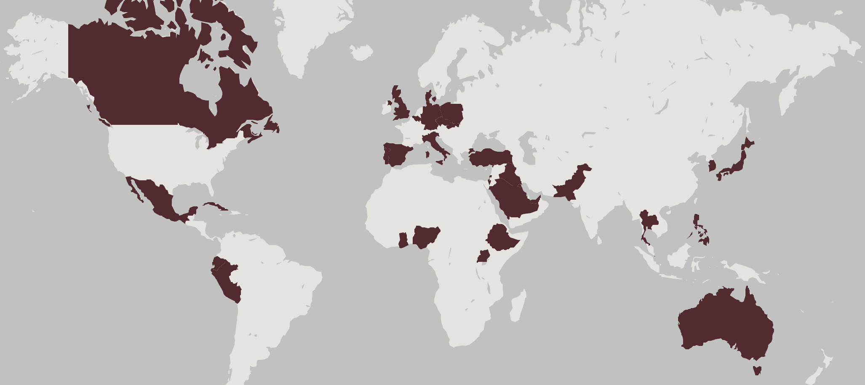
Learner Employment Sector and Region
Uniformed Services 8,402
Blurb about demographics
Government/Civilian 5,251
Contractor 1,364
Veterans Affairs 221
1,387 healthcare professionals in at least 40 countries or territories in the OCONUS service area enrolled in a CE event or course in 2024
Among those who enrolled, 1,116 completed the CE requirements for a total of 13,101.50 CE/CME credits
OCONUS Countries and Territories with Learner Enrollments
Notes:
Went to meetings and conferences to promote our program — clinical communities monthly meeting in early 2024 (10 min virtual presentation)
3C conference in May, with a booth with flyers (Dr. O gave similar presentation)
Booth at the MHS conference with 3 representative, which led to networking and making connections; Gained a speaker for a future CCSS meeting
Moving to adobe
Adding resources
Looking forward to 2025
**Maybe link to the site

Slide 5
Uniformed Service Members and MTFs
Blurb about service branches
Percentage of Service Member Credit Earners from Each Branch
Blurb about top MTFs
Top 10 MTFs by Number of CE/CME Credits Awarded to Affiliated Learners
MTF | Location | CE/CME Credits
Madigan Army Medical Center | Fort Lewis, Washington | 4,378.00
Brooke Army Medical Center | Bexar County, Texas | 4,151.70
Walter Reed National Military Medical Center | Bethesda, Maryland | 4,144.75
Womack Army Medical Center | Fort Liberty, North Carolina | 3,447.00
William Beaumont Army Medical Center | El Paso, Texas | 3,072.50
Alexander T. Augusta Military Medical Center | Fort Belvoir, Virginia | 2,862.00
Landstuhl Regional Medical Center | Landstuhl, Germany | 2,849.75
Evans Army Community Hospital | Fort Carson, Colorado | 2,433.75
Wilford Hall Ambulatory Surgical Center | Lackland AFB, Texas | 2,358.50
Naval Medical Center San Diego | San Diego, California | 2,019.25
Notes:
Went to meetings and conferences to promote our program — clinical communities monthly meeting in early 2024 (10 min virtual presentation)
3C conference in May, with a booth with flyers (Dr. O gave similar presentation)
Booth at the MHS conference with 3 representative, which led to networking and making connections; Gained a speaker for a future CCSS meeting
Moving to adobe
Adding resources
Looking forward to 2025
**Maybe link to the site

Slide 6
Learner Trends and Professions
Blurb / data about learner demographics
11,817 new accounts created in 2024; 9,296 completed a course in 2024; 6,078 returning users completed a course in 2024
Top Eight Professions by Number of Credit Earners per Corresponding Credit Type
Notes:
Went to meetings and conferences to promote our program — clinical communities monthly meeting in early 2024 (10 min virtual presentation)
3C conference in May, with a booth with flyers (Dr. O gave similar presentation)
Booth at the MHS conference with 3 representative, which led to networking and making connections; Gained a speaker for a future CCSS meeting
Moving to adobe
Adding resources
Looking forward to 2025
**Maybe link to the site

Slide 7
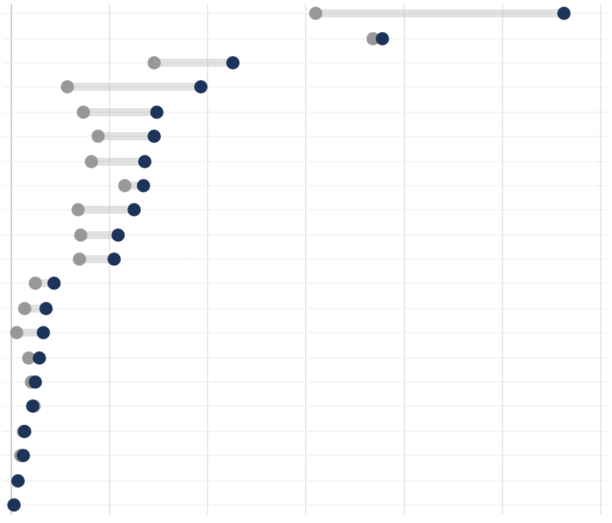
Accreditation Trends
Blurb about accreditation trends
Number of Credits Awarded by Credit Type
ANCC
ACCME
ACCME Non-Phys
APTA
IPCE
ADA
ASWB
AAPA
ACHE
ACPE-PHARM
APA
AOTA
NBCC
CDR
ACPE-TECH
BOC
ARBO / COPE
ASHA
AHIMA
CCMC
COPSKT
28,197.50
18,954.20
11,347.25
9,650.25
7,408.95
7,309.50
6,821.25
6,765.75
6,279.70
5,483.00
5,266.75
2,190.50
1,789.50
1,695.00
1,474.50
1,236.25
1,099.50
686.00
625.00
397.00
173.50
0 | 5,000 | 10,000 | 15,000 | 20,000 | 25,000 | 30,000
2023
2024
Notes:
Went to meetings and conferences to promote our program — clinical communities monthly meeting in early 2024 (10 min virtual presentation)
3C conference in May, with a booth with flyers (Dr. O gave similar presentation)
Booth at the MHS conference with 3 representative, which led to networking and making connections; Gained a speaker for a future CCSS meeting
Moving to adobe
Adding resources
Looking forward to 2025
**Maybe link to the site

